Slide 1
Fraud Detection by Abdulrahman Amer

Slide 2
DETECT FRAUD.

Slide 3
DATA
Fraud Dataset Kaggle.

Slide 4
Final Model
Identifies 99% of fraudulent activity.
Identifies 99.995% of non-fraud as non-fraud.
Identifies 1% fraud as non-fraud (False Positive).
Identifies .005% non-fraud as fraud (False Negative).

Slide 6
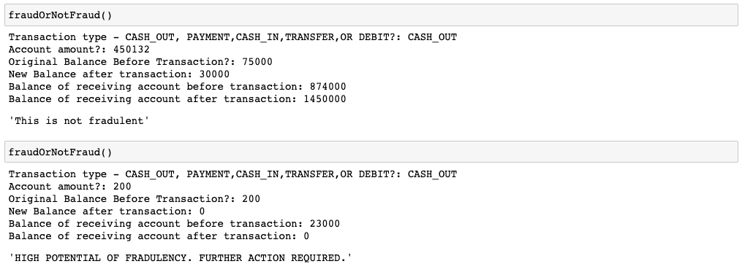
Plug and Play

Slide 7
What next? Future Projects.
Deployment.
Automation.
Collecting more data.

Slide 8
Questions?

Slide 9

Abdulrahman Amer
Email :
amer@rosny.com
LinkedIn: www.linkedin.com/in/abdulrahman-amer-machine-learning-a-i-data-science
GitHub:
https://github.com/AbdulrahmanAmer-R

